Slide 1
Collaborative Professional Services (CPS) Smart Talk Series 303

Slide 2

CPS Defined
Best In Class Partner Behavior
Use Cases
Customer Conversation
Notes:
2
Larry:
Before I turn it back over to Sandra to take us through the key program elements, are there any questions?
[Transition to Sandra]
Sandra:
Thank you, Larry.
Eligibility is the first of our key program elements so we’ll take a few minutes to walk through the eligibility framework for the program

Slide 3

The Collaborative Professional Services Portfolio

Slide 4


Collaborative Professional Services
Customer
Assessment Services:
Cisco Analyzes and Collects Data to Automate Professional Service Capabilities
Collaboration — Data Center/Virtualization — Borderless Networks — Cloud
Partner
Guidance Services and Development Services
Cisco validates or designs the Customer’s IT Infrastructure
Practice Accelerators
Assessment Services
Practice Accelerators:
Cisco Aids a Partner in Starting
a Practice in a Given Technology
Guidance & Development Services
Knowledge Services:
Access to Cisco knowledge base and service delivery tools & templates

Slide 5
Use Cases & Deliverables

Slide 6






Best in Class Partner Behavior
More Profitable
- GM are 3X larger than peers
- Perform Assessments 97% of the time, of which 83% are paid
More Efficient
- Projects are 97% more efficient
- Project waste less than 4%
Win More Deals
- Deals are 54% Larger
- More Complex
Notes:
Major technology shifts are affecting business models.
Mobility. Across the globe mobility is becoming essential to our everyday experience. You can argue that countries like Japan and Korea were out in front on this. For years now their mobility experience has gone far beyond mobile voice. The same goes for the Scandinavian countries. The rest of the world is catching up fast though.
- O2 reported that across Europe in 2009 its mobile data traffic doubled every three months. That qualifies as “unprecedented growth”!
- In North America, AT&T recently reported a 5000 percent jump in mobile data traffic in the last three years
- Worldwide, mobile data traffic is projected to double every year through 2014, increasing 39 times between 2009 and 2014.
Cloud and Virtualization. According to the Gartner Group, 20 percent of all businesses will own no IT assets by 2012. This is a major departure from the past, and speaks to the ways that technology is having a fundamental impact on business models. Technologies such as cloud computing and virtualization now enable organizations to shift resources to more strategic projects.
- A recent study completed by Evans Data noted that three-quarters of IT firms plan to virtualize clients within the next year
- While Forrester has noted that over 25% of software will likely be purchased on a hosted basis over the next five years
Video. Video is bringing people together and changing how organizations communicate, collaborate, educate and protect. It is a market transition as organizations use a variety of video applications for teleconferencing, employee training, surveillance, meetings, digital signage and more. Video is creating massive IP traffic.
- The Cisco Visual Networking Index (VNI) forecast indicates that by 2014, the various forms of video will exceed 91 percent of global consumer traffic.
- Today, here at Cisco, 50% of our network traffic is video.
____________________________________________________________________________________________
Source: Gartner “Gartner Top End User Predictions for 2010: Coping with the New Balance of Power”
Source: Cisco Visual Networking Index (Video)

Slide 7
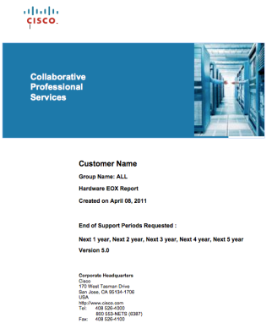

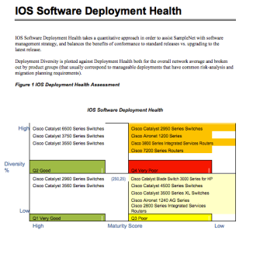
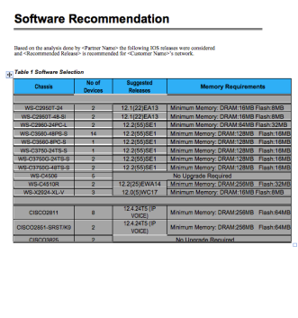
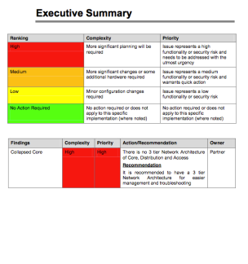
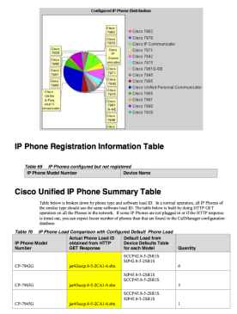
Assessment Services
Assessment Services
Routing & Switching Assessment Service
Routing & Switching Assessment Service Multipack
Multi-Day Router & LAN Switch Audit Service
Network Device Security Assessment Service
Borderless Networks
Video Service Level Agreement Assessment Service
Unified Communications Readiness Assessment Service
Unified Communications Manager Assessment Service
Unified Messaging Assessment Service
Unified Contact Center Assessment Service
Nexus 7k & UCS Assessment
Collaboration
Data Center, Virtualization, and Cloud

Slide 8


Collaborative Professional Services Value Proposition –CPS Assessments
Partner Customer Engagement Model
CPS Benefits to Sales Process
CPS
Assessment
Sales
Build and Defend BOM
Sales
Build and Defend SOW
Delivery
Protect Customer
Customer Care
Monetize Presales
Notes:
What it is; how we do it
What partner already does; how they combine w/CPS to improve their processes
ie; replacing a manual process; compare what they do today w/what CPS can do

Slide 9
Building & Defending a BOM & SOW
Without Assessments
With Assessments
Compete on Price
BOM shrinks due to competition
Difficult to differentiate
Profitability tied to change orders
Accurate Scoping & pricing Maximize engineering skills Capture all revenue opportunities Minimize support costs
Notes:
Without Assessments
Compete on Price
BOM are eroded by Partner to win the business
Difficult to differentiate – All Partners are equal
Profitability is tied to Change Orders
Benefits of Assessments to Statement of Work & Bill of Materials
Scoping – accurate and demonstrable infrastructure view
Staffing – maximizing engineering skills sets to projects is critical to profitability.

Slide 10
Protect Your Customer & Yourself
Customer
Your Practice
Simplify the budget process Ensure success & keep stakeholders informed Maximize investment by preparing for the future
Differentiate through services Better utilize engineering resources
Sell value not people Position yourself for long-term engagement
Notes:
Pricing – capture all revenue opportunities
Partner
Solution Services is how you differentiate
Engineering & Project Resources are fixed, ongoing, and expensive
Trading time for money exposes the delivery organization
Change Orders in projects elongate Sales Cycle
Customer
Focus is shifted from Business Requirements to Best Price
Projects delayed mid-stream to seek additional budget
Executive Mgt loss of confidence in IT projects

Slide 11

Shorten the Sales Cycle
Best Practice Methodology promotes confidence
Fixed Priced, Fixed Scope SOW & BOM
Customer buying on value not price
Real Data exposes projects risk
Assurances & Guarantees eliminate competition
Notes:
Shared risk, shared reward.

Slide 12
Collaborative Professional Services PBX (Phone System) to UC Migration [Project Level]
1
Partner +
Cisco
Perform Cisco Network Readiness Assessment
Determine Voice Readiness of Network
Replace and Upgrade Core Elements to Make Network Ready for Voice
2
Partner +
Cisco
Perform Cisco Unified Communications Planning & Design Development Service (Communications Manager/Unity/Unified Contact Center Enterprise)
High-Level and Detailed Design • Migration Plan
Implementation Plan • Systems Acceptance Plan
3
Partner
Migrate Customer from Legacy PBX and Rollout Unified Communications Solution
4
Partner +
Cisco
Perform Cisco Unified Communications Assessment (Communications Manager/Unity/Unified Contact Center Enterprise)
Validate Entire Unified Communications Implementation
Develop As-Built Documentation for End User or Managed Services Business
Notes:
Use Case: Improving an existing practice
Type: Project level engagement

Slide 13
Collaborative Professional Services Value Proposition –CPS Assessment
Partner Customer Engagement Model
CPS Benefits to Delivery Process
Sales
Validate Design
CPS
Assessment
Create Proof Point
Delivery
Delivery
Generate End Customer Documentation
Customer Care
Close Out Project
Notes:
What it is; how we do it
What partner already does; how they combine w/CPS to improve their processes
ie; replacing a manual process; compare what they do today w/what CPS can do

Slide 14
Create proof points & validate designs
Customer
Your Practice
Control Point in projects
Executive Visibility
Investment protection
Improved technology adoption
Respond faster to challenges
Switch from Senior to Junior engineers
Maximize engineering resources
Justify scoping, staffing and pricing
Notes:
Pricing – capture all revenue opportunities
Partner
Solution Services is how you differentiate
Engineering & Project Resources are fixed, ongoing, and expensive
Trading time for money exposes the delivery organization
Change Orders in projects elongate Sales Cycle
Customer
Focus is shifted from Business Requirements to Best Price
Projects delayed mid-stream to seek additional budget
Executive Mgt loss of confidence in IT projects

Slide 15
Close Out Projects Faster
Provide documentation of project completion
Maximize Engineering & Project Resources
Create Compelling Event for Billing
Eliminate white space between projects
Quickly Shift from Delivery back to Sales mode
Correlate Project Close to original BOM & SOW
Provide Success tools for Customer & their Management

Slide 16
Collaborative Professional Services Value Proposition – Generic CPS Assessment
Partner Customer Engagement Model
CPS Benefits to Customer Care
Sales
Create Long Term Relationship
Influence Budget
Delivery
CPS
Assessment
Block Competition
Customer Care
QBR
Pull-through Hardware and Software
Notes:
What it is; how we do it
What partner already does; how they combine w/CPS to improve their processes
ie; replacing a manual process; compare what they do today w/what CPS can do

Slide 17
Bock Out Competition & Influence Budget
Customer
Your Practice
Free up IT resources
Plan effectively for the future
Minimize downtime
Maintain compliance
Add differentiated value
Create recurring revenue
Provide informed recommendations
Establish predictable buying cycle for hardware & software
Notes:
Free up Customer IT Resources
Empower Customer to be more Proactive
Add Value that cannot be easily displaced
Integrate into Stakeholders Review with Senior Mgt
Integrate into IT roadmap
Pull Through Hardware & Services

Slide 18
Customer Conversation

Slide 19

CUSTOMER CONVERSATION

Slide 20
“You’ll likely receive bids from several competitors who are eager to quote a low price and fast delivery. But beware.
This may pose a serious risk, since they may not have an accurate view of your network limitations today.”

Slide 21
“If you’ll allow us to conduct a detailed CPS network assessment, we can gain expert insight and a complete picture of your existing network”

Slide 22
“This information—based on quantitative analysis from Cisco—helps us build an BOM and SOW that we personally guarantee.”

Slide 23
“As you compare your project bids, watch out for vendors who are willing to quote prices without having a full understanding of your network.
With an accurate BOM and airtight SOW, we can stand behind our project estimates with confidence.”

Slide 24
“Plus, you’ll impress company executives by having a concrete budget, detailed work plan and a partner vendor who’s willing to guarantee their work ”

Slide 25
“You won’t need to waste time comparing a large number of diverse bids, assessing the risks with each one and negotiating between multiple vendors.”

Slide 26
“You’ll already have a detailed plan that’s based on factual knowledge and a deep understanding of your current network needs—plus a partner willing to stand behind its bid.”

Slide 27
“You’ll be able to make a confident decision more quickly, and get the project started.”

Slide 28
“Because these assessments offer such far-reaching business value, we do charge a fee for the service.
However, they also enable us to guarantee our BOM/SOW and protect your budget and timeline—so it’s an investment well spent.”

Slide 29
Collaborative Professional Services PBX (Phone System) to UC Migration [Project Level]
1
Partner +
Cisco
Perform Cisco Network Readiness Assessment
Determine Voice Readiness of Network
Replace and Upgrade Core Elements to Make Network Ready for Voice
2
Partner +
Cisco
Perform Cisco Unified Communications Planning & Design Development Service (Communications Manager/Unity/Unified Contact Center Enterprise)
High-Level and Detailed Design • Migration Plan
Implementation Plan • Systems Acceptance Plan
3
Partner
Migrate Customer from Legacy PBX and Rollout Unified Communications Solution
4
Partner +
Cisco
Perform Cisco Unified Communications Assessment (Communications Manager/Unity/Unified Contact Center Enterprise)
Validate Entire Unified Communications Implementation
Develop As-Built Documentation for End User or Managed Services Business
Notes:
Use Case: Improving an existing practice
Type: Project level engagement

Slide 30


Slide 31
声明：
所有的版权属于原有公司，文件均来自公开渠道
此文件仅供学习使用，任何人不得进行以此为商业目的的行为
如有疑问，请立即删除
学习世界五百强和咨询公司PPT课程请访问如下网站搜索：“司马懿”
百度传课：司马懿PPT学校
网易学堂：司马懿PPT学校
知乎： 司马懿PPT学校
访问地址
https://www.chuanke.com
访问地址
https://study.163.com
访问地址
https://www.zhiu.com

